Slide 1





MAJOR PROJECT - PHASE-II REVIEW
BrandCraft
Generative AI-Powered Branding Automation System
Student Names And Roll No:
Mohammed Muzzamel Ahmed 160923750131
Ausaaf Syed Ahmed 160923750123
Mohd Khader Uddin Khan 160923750305
Department:
Computer Science Engineering (Data Science)
Project Guide:
Mr.Md Ashique Hussain
Notes:
Introduce the project: BrandCraft is an AI system that builds a complete brand from a business idea. Fill in team names, roll numbers, department and guide before the review.

Slide 2


Introduction
Why it is important
What is BrandCraft?
An AI-powered website that helps anyone build a complete brand - logo, colors, fonts and social media posts - starting from just a business idea.
Saves time and money
Brand work that took weeks is done in minutes.
Same look everywhere
Background
Colors, fonts and tone stay the same everywhere.
Every business needs a strong brand to earn trust. But making one usually needs designers, writers and marketers, which costs a lot of time and money.
Helps small businesses
Startups get expert branding without a big team.
Built for:
Entrepreneurs
Startups
Marketers
Enterprises
Notes:
BrandCraft is an AI website that creates a whole brand - logo, colors, fonts, and posts - from a simple business idea. Explain the background first, then why it matters.

Slide 3


Problem Statement
Startups and small businesses find it hard to build a professional brand, because it is costly, slow and spread across many separate tools.
Costly
Slow
Scattered
Inconsistent
Agencies and designers need a big budget.
Brand strategy and design can take several weeks.
Logo, content and posts live in different apps.
Colors, fonts and tone change across channels.
The need: one smart, connected platform that creates and manages the whole brand automatically.
Notes:
The problem: small businesses cannot easily afford or manage professional branding. It is costly, slow, spread over many tools, and often inconsistent.

Slide 4

Existing System
Current methods
Limitations
Agencies and designers
Very expensive for small businesses
Takes weeks to finish a brand
Tools are disconnected, so work is repeated
Generic AI gives mismatched styles
Team work is scattered
Little control over AI models and cost
Experts do research, logo, colors and content step by step, with many meetings.
Separate design tools
One app for logos, another for posts, another for campaigns.
Generic AI tools
Make text and images fast, but do not remember the brand style.
Notes:
Today people use agencies, separate online tools, or generic AI tools. Each has limits - cost, disconnected work, and AI that forgets the brand style.

Slide 5







Proposed System
Business idea
AI wizard
AI agents team
Creative studios
Assets and export
One shared brand memory
A team of AI agents
All AI agents use the same brand details, so every result matches.
Strategist, Designer, Copywriter, Marketing, Campaign and Social Media agents.
Everything in one workspace
Admin control center
Create, save, reuse, schedule and export without switching apps.
Admins manage AI models, prompts, feedback, users and costs.
Notes:
BrandCraft connects everything: idea goes into the wizard, AI agents work together, studios create content, and everything is saved and exported from one place.

Slide 6

Objectives
1
2
3
Automate branding
Keep brand consistent
Save time and cost
Create brand strategy, colors, fonts and logo ideas from a simple business idea.
Use one shared brand context so all text and visuals match.
Make professional branding easy for startups and small teams.
4
5
6
Create content easily
Support teamwork
Give admins control
Generate marketing, campaign and social media content in one workspace.
Let teams collaborate and schedule repeated tasks automatically.
Manage AI models, prompts, data, usage and costs in one place.
Notes:
These are the six main goals of the project. Each one answers a limitation of the existing system.

Slide 7




Scope of the Project
Applications - where it can be used
Future scope
Startups and entrepreneurs
Learn from user feedback to make the AI smarter
Predict usage, demand and revenue
Connect with more tools such as CRM platforms
Support more AI models and bigger teams
Build a first brand quickly
Marketing teams
Plan campaigns and social posts
Enterprises
Keep many teams on one brand style
Online stores and websites
Connect with Shopify, Mailchimp, WordPress
Clients and printers
Share brand kits and PDF guidelines
Notes:
Applications show who can use BrandCraft today. Future scope shows how the system can grow using ideas from our design.

Slide 8


Methodology - Workflow
1. Login and input
2. Brand wizard
3. AI agents work
User signs up and shares the business idea, goals and audience.
A step-by-step AI wizard collects style and brand values.
Strategist plans first, then Designer, Copywriter and other agents follow.
4. Studios create
5. Save and reuse
6. Export and publish
Four studios make logos, ads, campaigns and social posts.
All results go to the Brand Asset Repository for the team.
Download brand kits and PDF guides, or schedule posts and connect apps.
Admin and AIOps layer watches every step: AI models, prompts, monitoring, user feedback, costs and background jobs.
Notes:
Follow the numbers: user input, wizard, AI agents, studios, saving assets, then export. The admin layer watches over every step.

Slide 9
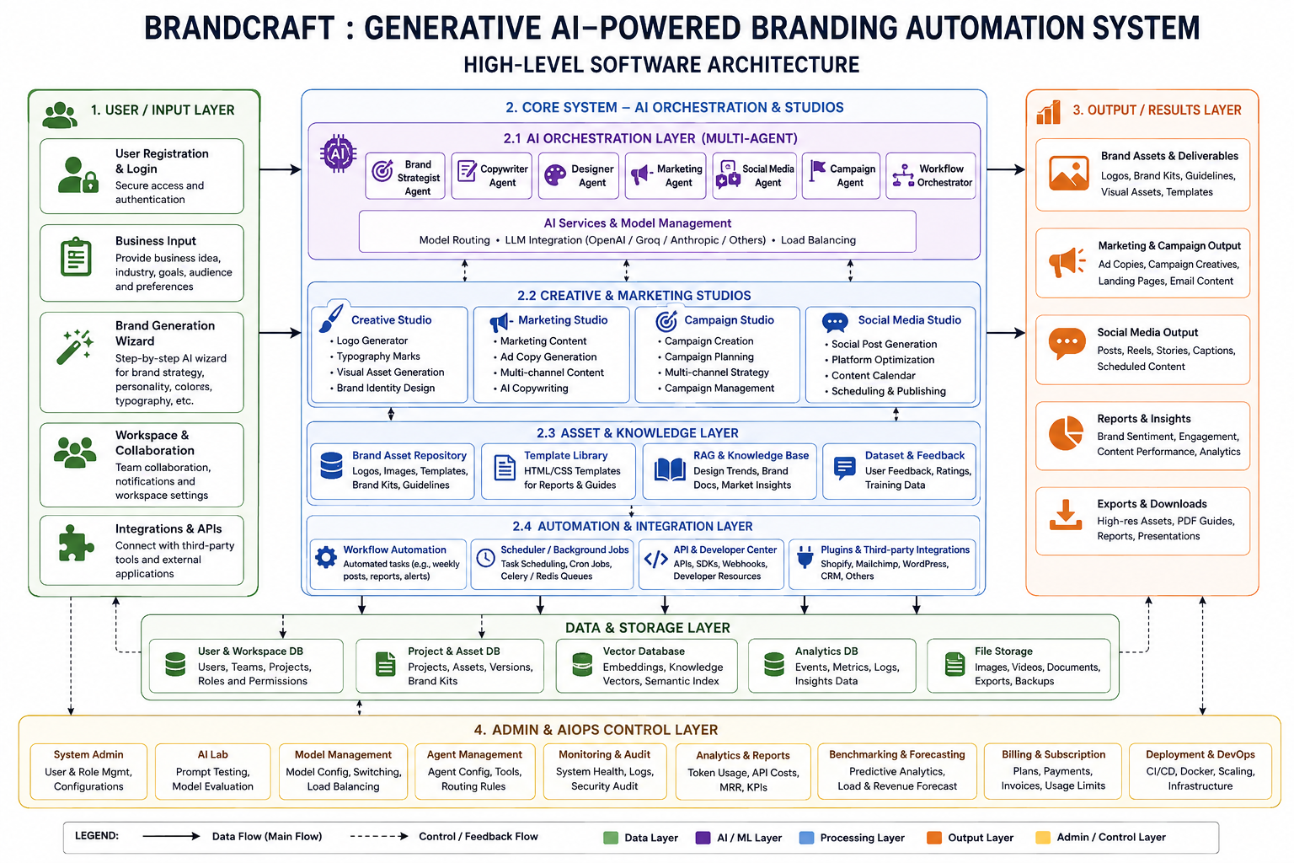
Methodology - System Architecture
1 Input layer
Users log in, enter their idea and use the wizard.
2 Core system
AI agents, studios, asset library and automation.
Data and storage
Databases, vector database and file storage.
3 Output layer
Brand kits, content, reports and exports.
4 Admin and AIOps
Control models, agents, billing and monitoring.
Notes:
This is the high-level architecture from our project document. It has an input layer, a core AI system, an output layer, data storage, and an admin control layer.

Slide 10





Technologies Used
Generative AI and Multi-Agents
APIs and Integrations
RAG and Vector Database
LLMs from OpenAI, Groq, Anthropic and others. Agents share work, with model routing and load balancing.
REST APIs, SDKs and webhooks connect BrandCraft with Shopify, Mailchimp, WordPress and CRMs.
Design trends and brand documents are stored as embeddings so AI gives smarter answers.
Celery and Redis
Databases and Templates
Docker, CI/CD and Cloud
Run long AI jobs and scheduled tasks in the background, so the app stays fast.
Store users, projects, assets and analytics. HTML/CSS templates create reports and PDF guides.
Package the app in containers, release it automatically and scale it on the cloud.
Notes:
These are the technologies named in our architecture and modules. In simple words: AI models make the content, RAG gives them knowledge, Celery and Redis run background jobs, Docker and CI/CD release the app.

